Slide 1

AI-Based Crime Prediction and Analysis System for Smart Cities
Supervisor
Dr.G. Anitha
Professor
Institute of SIMATS
Saveetha School of Engineering
Research Scholar
D V Sai kumar
192372321
Institute of SIMATS
Saveetha School of Engineering
1

Slide 2
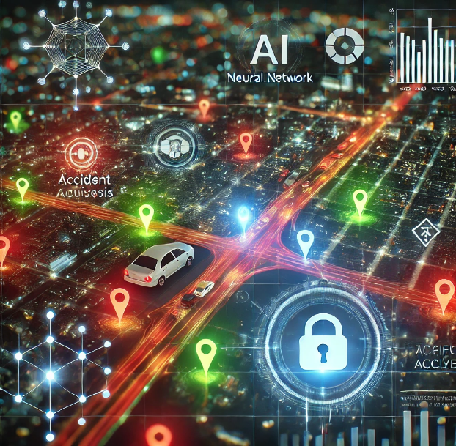
Introduction
Urban Crime Growth: Traditional methods
are inadequate for modern smart cities.
AI Prediction: Uses AI/ML to forecast
crime using real-time and historical data.
Smart Policing: Helps law enforcement
with proactive, data-driven decisions.

Slide 3
Problem Statement
Ineffective Traditional Methods: Conventional
crime analysis relies on manual processes, leading to slow and reactive responses.
Lack of Predictive Tools: Current systems fail to
utilize real-time data and advanced analytics to forecast criminal activities.
Resource Allocation Issues: Law enforcement
struggles with optimizing patrol routes and manpower without data-driven insights.

Slide 4
objective
To develop an AI-based system that predicts and analyzes crime patterns using historical and real-time data.
To assist law enforcement agencies in making proactive, data-driven decisions for crime prevention.
To enhance public safety and optimize resource allocation in smart city environments.
To provide intuitive visualizations and geospatial mapping for better situational awareness and planning.

Slide 5
Literature Survey
Predictive Policing Using Machine Learning Researchers have explored various machine learning algorithms such as Decision Trees, Random Forest, and Naive Bayes to predict crime types and locations. For example, the Chicago Crime Dataset has been widely used to train models that identify crime hotspots and recurring patterns.
Crime Mapping and Hotspot Analysis Geographic Information Systems (GIS) have been utilized to map crime locations and detect spatial patterns. Heatmaps generated from crime data allow for visual representation of high-risk areas, aiding in resource deployment and strategic planning.

Slide 6
Datasets
The system uses publicly available crime datasets such as the Chicago Crime Dataset and Crime Open Database (USA). These datasets include information like crime type, location, date, and time, which are essential for training and evaluating predictive models
Methodology
Data Collection: Obtain historical crime data from public sources.
Preprocessing: Clean and prepare data for analysis.
Model Training: Apply ML algorithms to learn crime patterns.
Prediction: Forecast crime types and hotspots.
Visualization: Display results using maps and heatmaps.

Slide 7
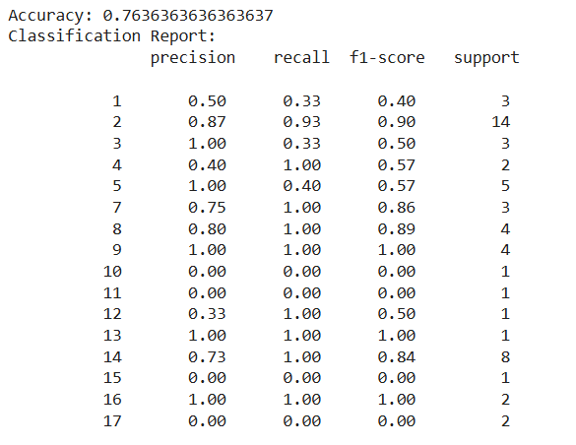
Results

Slide 8
Prediction Accuracy: The machine learning models, especially Random Forest and Decision Tree, achieved an accuracy of around 80–85% in predicting crime types and hotspots.
Hotspot Identification: The system successfully identified high-crime zones and visualized them using interactive heatmaps and GIS mapping.
User Interface: A simple, user-friendly dashboard was developed, allowing users to input data and receive real-time crime predictions and visual analysis

Slide 9
Conclusion
The AI-Based Crime Prediction and Analysis System offers a powerful tool for enhancing public safety in smart cities. By leveraging machine learning and real-time data, the system enables proactive crime prevention and smarter resource allocation. Through predictive analytics and visual mapping, law enforcement agencies can respond more effectively, reduce crime rates, and build safer urban environments. This project demonstrates the potential of AI to transform traditional policing into a data-driven, intelligent system aligned with the goals of smart city development.

